Slide 1
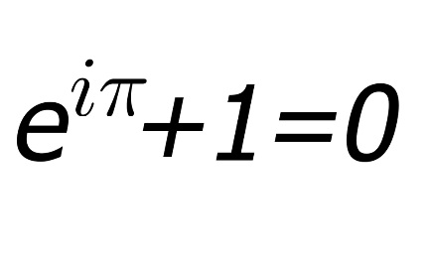

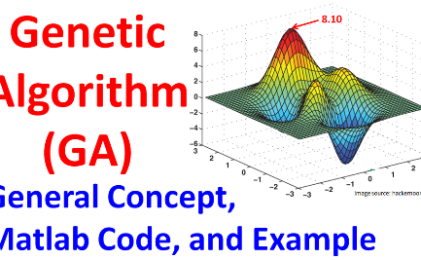
The Art of Numerical Solutions
Aesthetics in Mathematics
Advancing Scientific Research
The Role of Algorithms
Delve into the algorithms used to implement Euler's and Runge-Kutta methods, from pseudocode to practical implementations.
Explore the profound beauty and elegance found in numerical solutions of differential equations, where art and mathematics intertwine.
Learn how numerical methods like Euler's and Runge-Kutta contribute to scientific discoveries and enable simulations in various fields.

Slide 2
Relevant Information
A wonderful serenity has taken possession of my entire soul, like these sweet mornings of spring
Net vs Gross
$5,670,000
53,760
53,760
A wonderful serenity has taken possession of my entire soul
A wonderful serenity has taken possession of my entire soul,
$5,670,000
53,760
53,760
A wonderful serenity has taken possession of my entire soul
A wonderful serenity has taken possession of my entire soul

Slide 3
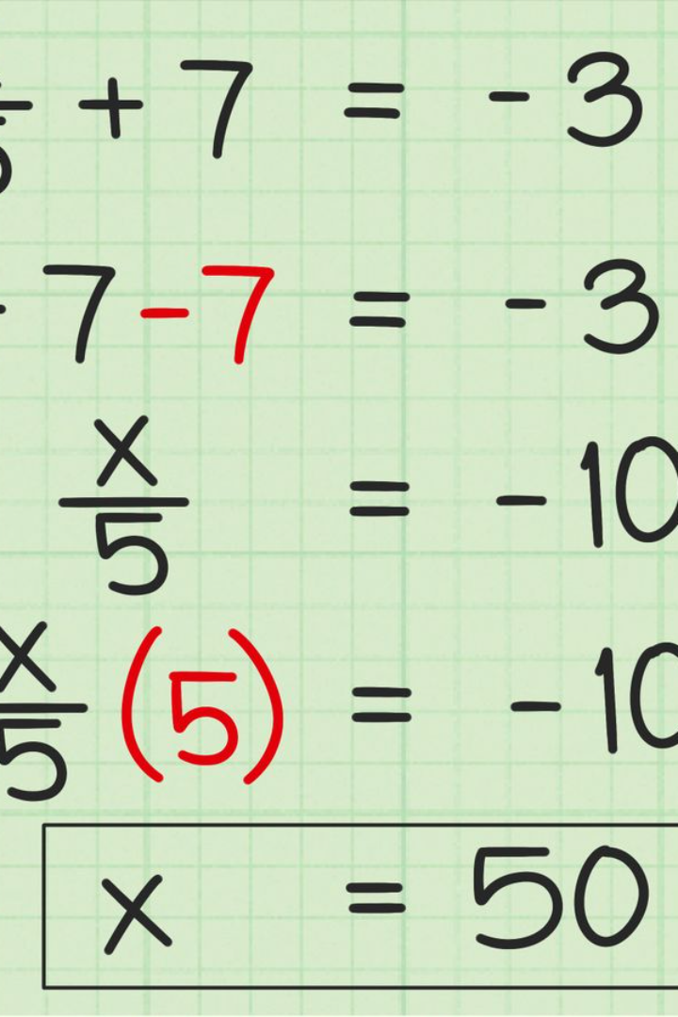

Introduction to Ordinary and Partial Differential Equations
Alright, imagine you have a box of crayons, and each crayon has a different color. Now, let's say you want to know how much each color is different from the others. That's a bit like what differentiation is.
Calculus makes it possible to understand not just how something changes over time, but how it changes in an instant.
Differential equations are mathematical equations that involve one or more derivatives of an unknown function. They are used to model relationships and describe the behavior of systems in various scientific fields.
by Group 5

Slide 4
BASIC CONCEPTS
Linear and Non-Linear Differencial Equation
For Any form of Differential Equation f(x,y,y’,y’’...y^n)=0
it is considered linear if it satisfies the following conditions
All derivative and dependent variable are of the First order.
There does not exist any product form of dependent variable and it’s derivative.
Examples of Linear and Non-Linear.
y’ + X^2 = 4
y’’ + 3y’^2 + 7y = x
d^2x/dy^2 + dx/dy + y = x^2
y’’ + siny = 0
yy’ + ysinx = x^2
Independent Variables & Dependent Variable:
The dependent variable is the quantity that we are trying to slove for or understand. It’s the variable whose value is to be obtained.
Where as the Independent Variable is not influenced by any other variables, It is the variable that we have control over and can manipulate.
It is the variable to which a value is assigned to.
y = x^2 + x
z = x^2 + y^2
dy/dt = -2y
In this equation, (t) is the dependent variable, representing the amount of a substance at any given time t. The independent variable, t, represents time.
The equation states that the rate of change of y with respect to t is equal to -2 times y. Here, the independent variable (time) influences the dependent variable (amount of substance), causing it to decrease exponentially.

Slide 5
ODEs | PDEs
ODEs: Describe how a single variable changes over time | PDEs: Describe how multiple variables change over time and space
ODEs: Involve one independent variable (e.g., time) | PDEs: Involve multiple independent variables (e.g., time and space)
ODEs: Used to model phenomena like temperature change over time | PDEs: Used to model phenomena like heat distribution or fluid mechanics.
dy/dx = f(x, y)
Is an example of an ODE with a single dependent and Independent Variable.
dy/dt = 3x + 2y
dx/dt = x + 2y
In this case we have more that one dependent variable.
It is called a system of ODE.
Here is an Example of a PDE with more than one Independent Variable.
2xdz/dx + 5ydz/dy = 1

Slide 6
Ordinary Differential Equations (ODE’s)
An ODE involves an unknown function of one variable and its derivatives.
General form: F(x, y, y', y'', ..., y^(n)) = 0, where y' represents the first derivative of y, and n is the order of the highest derivative.
Components of an ODE
- Dependent Variable (y): Represents the unknown function of interest.
- Independent Variable (x): The variable with respect to which differentiation occurs.
Derivatives: Express how the dependent variable changes concerning the independent variable.
Order of ODEs
- First-Order ODEs: Involves only the first derivative of the unknown function.
dy/dx = 2x - 3y
- Second-Order ODEs: Involves up to the second derivative, and so on.
d^2y/dx^2 + 3(dy/dx) + 2y = 0

Slide 7
Solving Examples
1. F =ma
2. s(t) = 3t^2 + 2t + 1
3. Does x = e^3t satisfy d^3x/dt^3 - 9d^2x/dt^2 = 0
4. d^2x/dt^2 = 3t +1 at init point x(0) =2
x’(0)=3

Slide 8
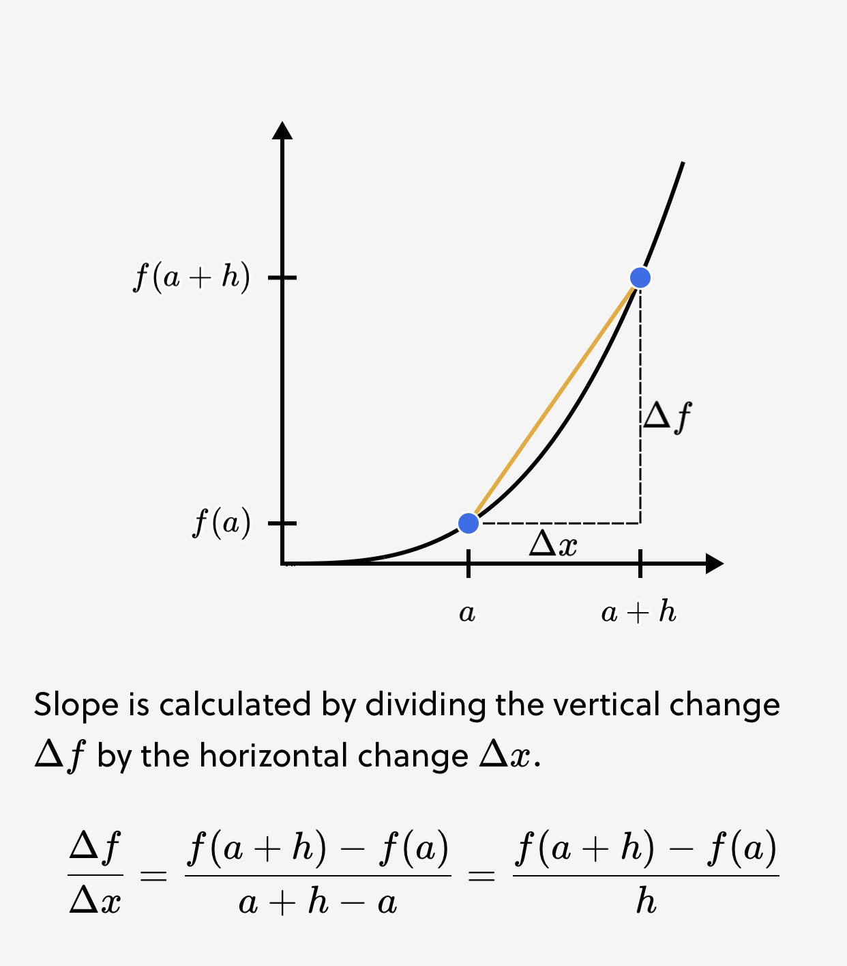
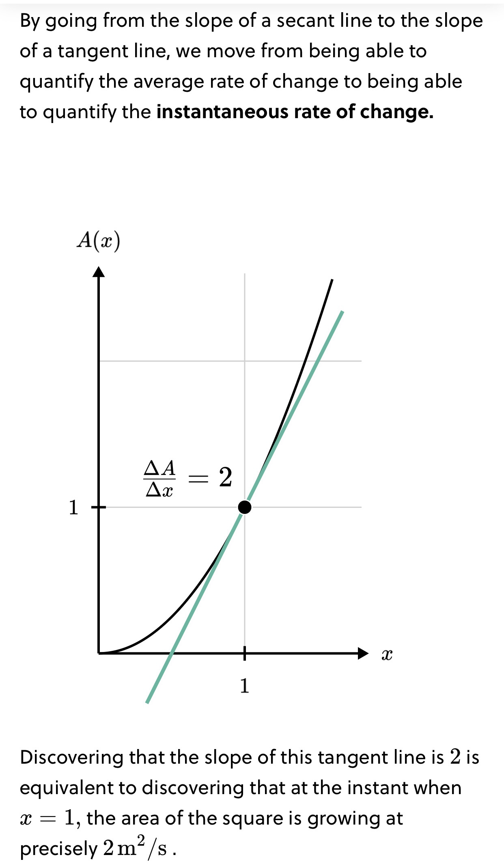
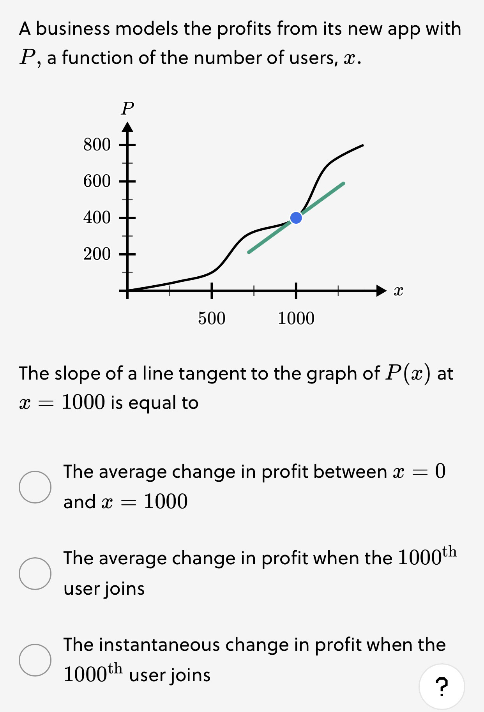
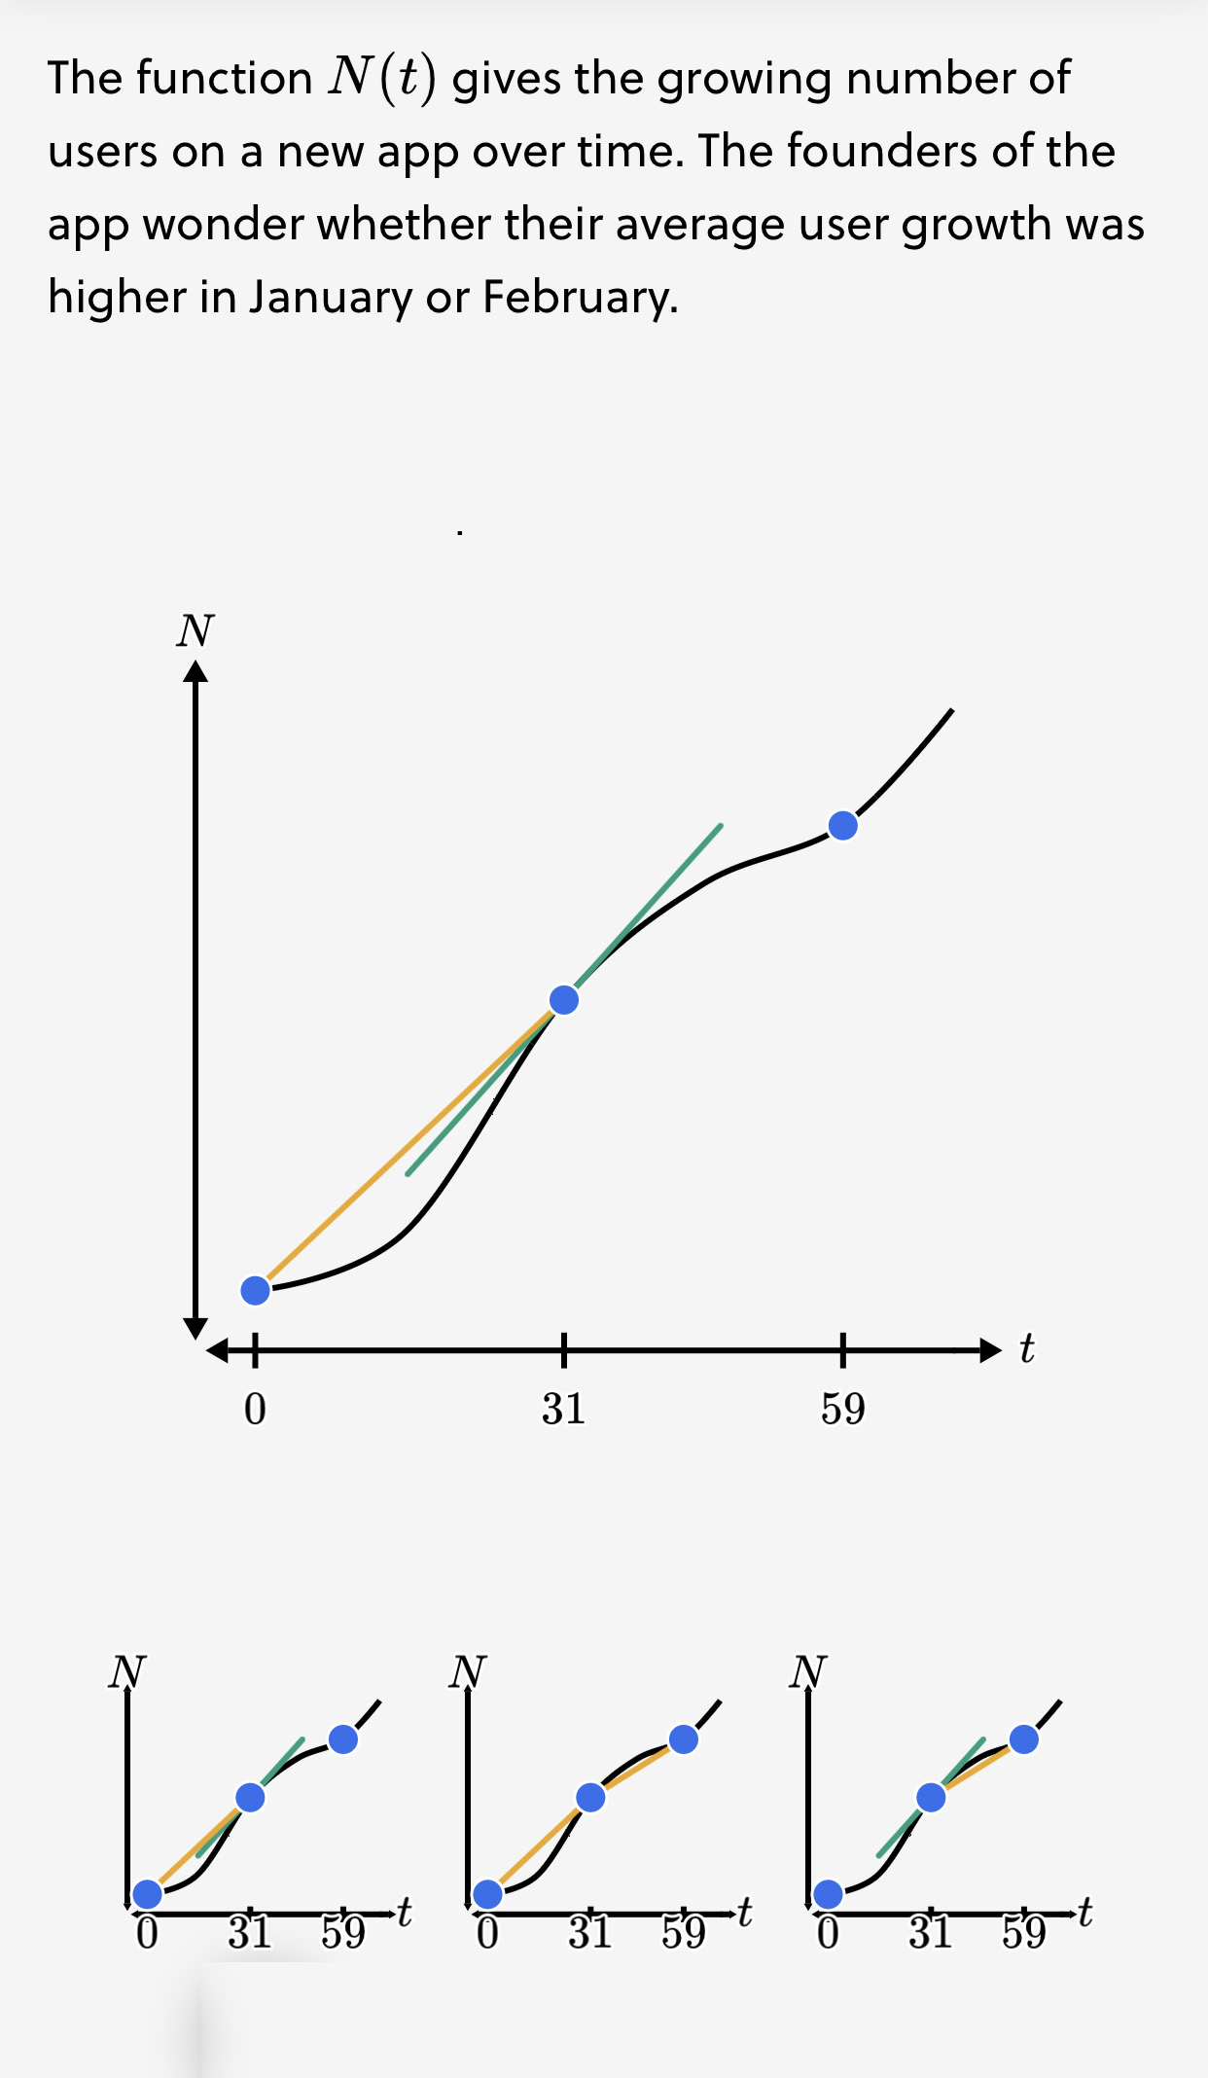
Understanding Differential Equations with Euler & Runge-Kutta Methods.
In the world of Differential Equations, Euler and Runge-Kutta methods play a crucial role in making complex problems simpler.
Think of Euler's method like taking small, straightforward steps, offering quick insights. On the other hand, Runge-Kutta adds finesse with its higher accuracy, creating a more precise solution. Together, they form a powerful duo, allowing us to explore a variety of scenarios with ease.
Euler's simplicity gives us quick answers, while Runge-Kutta's accuracy ensures we get the right picture. These methods are like tools that help us uncover the hidden stories in Differential Equations. By working together, they provide a balanced approach, turning complicated problems into solvable puzzles for real-world issues.

Slide 9
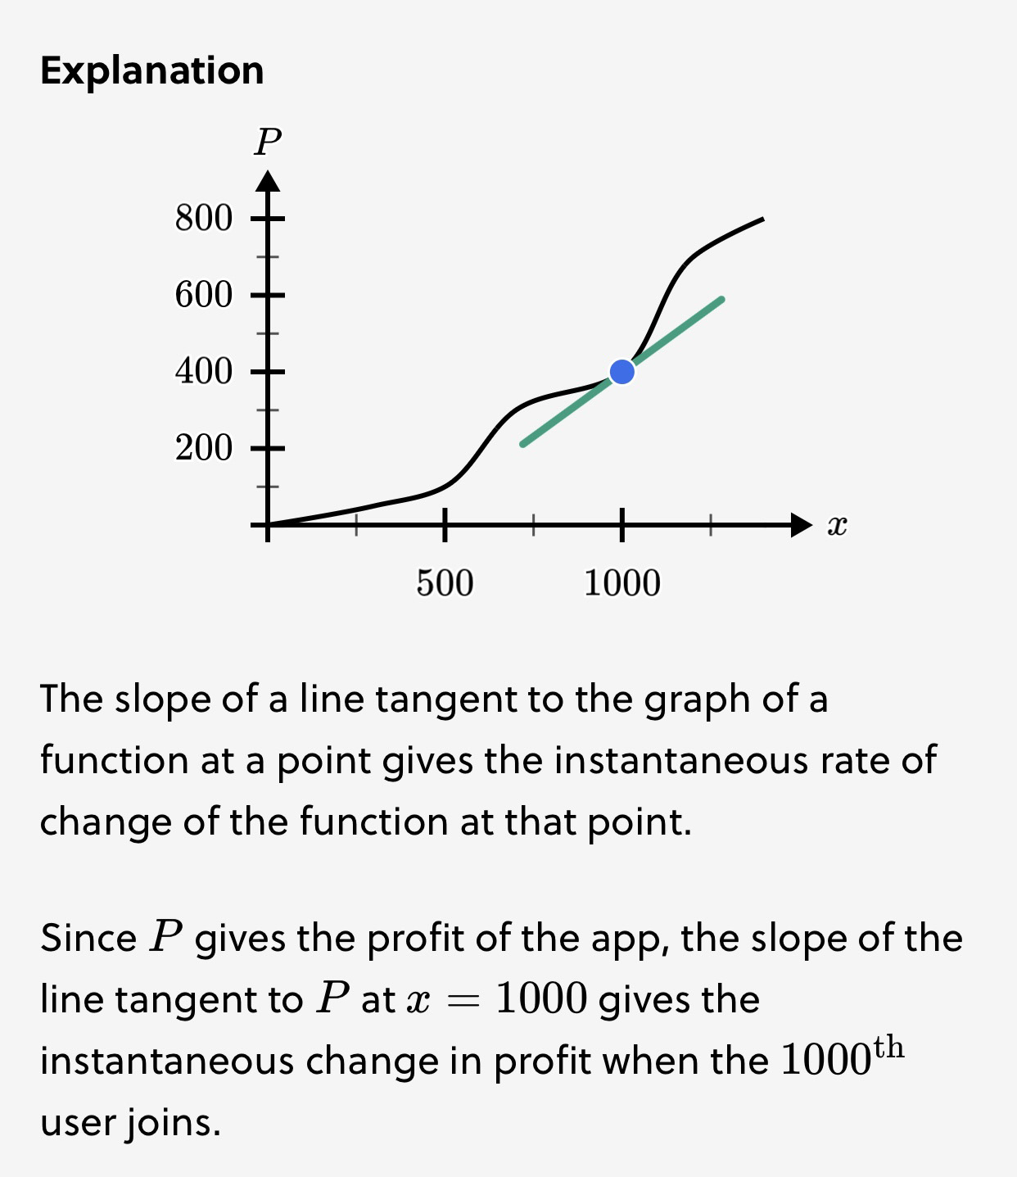
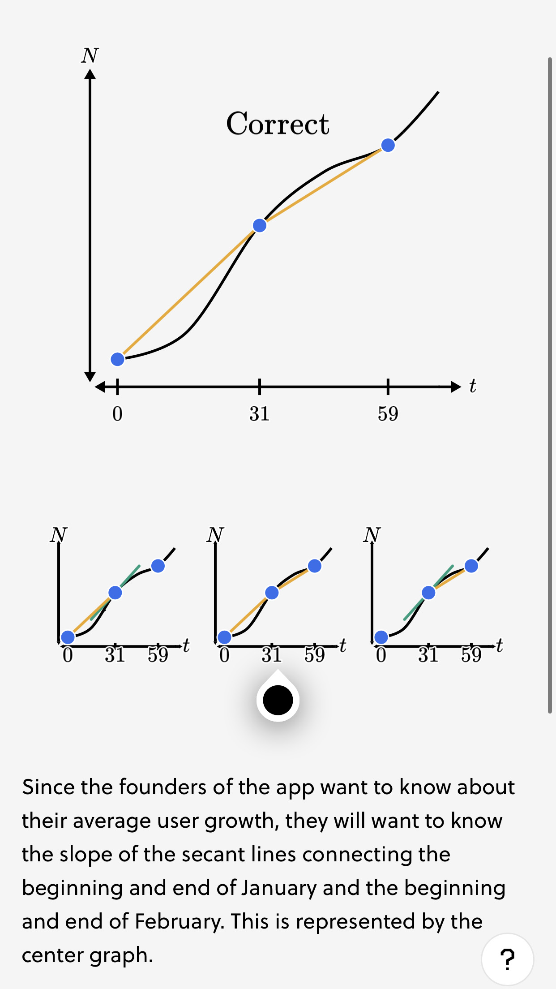
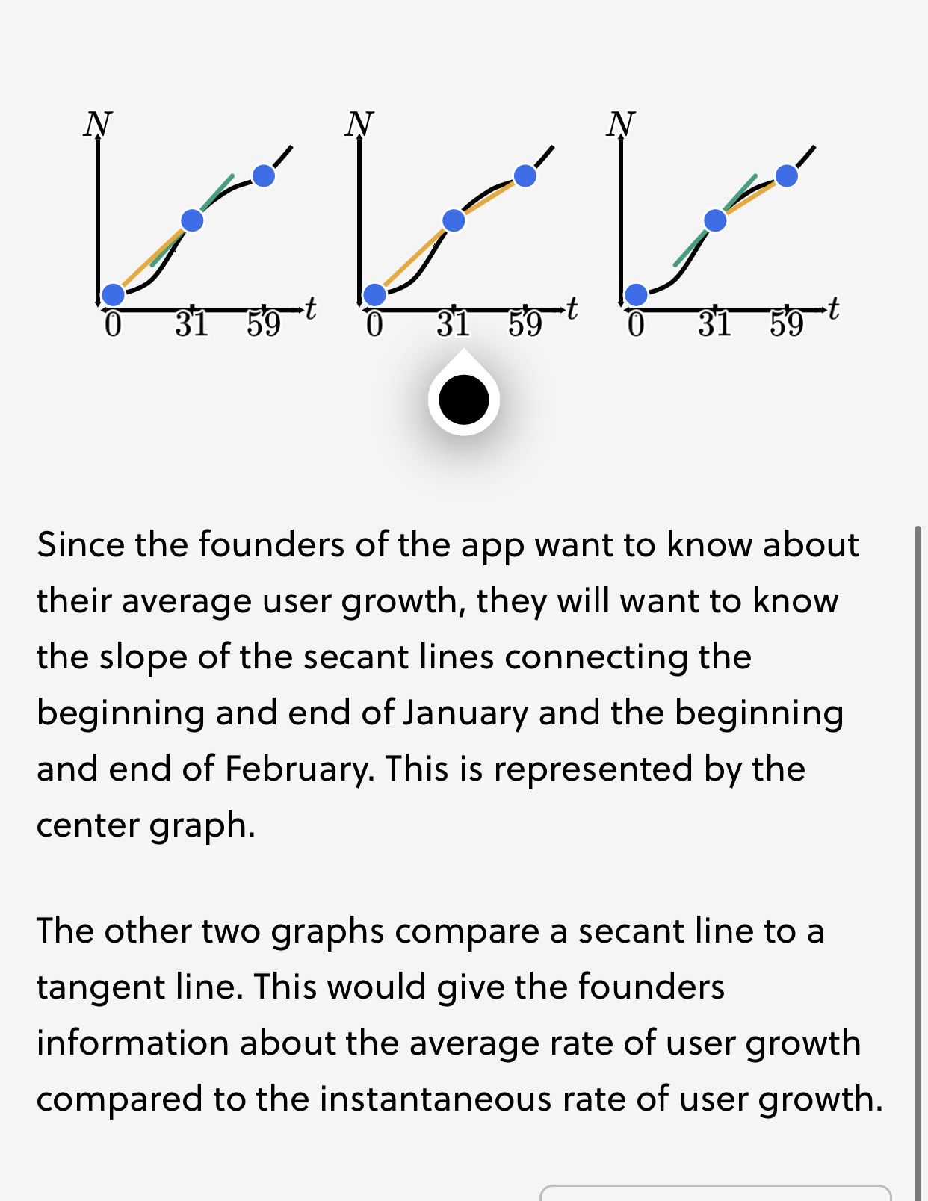

Slide 10

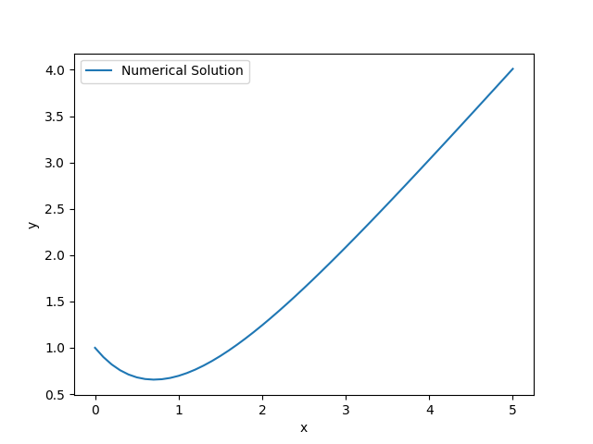
Euler's Method for Solving ODE
import numpy as np
import matplotlib.pyplot as plt
# Define ODE and Euler Method
def f(x, y):
return x - y
def euler_method(func, x0, y0, h, n):
x_values = [x0 + i * h for i in range(n+1)]
y_values = [y0]
for i in range(n):
y0 += h * func(x_values[i], y0)
y_values.append(y0)
return x_values, y_values
# Example Usage
x0, y0 = 0, 1 # Initial conditions
h = 0.1 # Step size
n = 50 # Number of steps
x, y = euler_method(f, x0, y0, h, n)
# Plotting
plt.plot(x, y, label='Numerical Solution')
plt.xlabel('x')
plt.ylabel('y')
plt.legend()
plt.show()

Slide 11
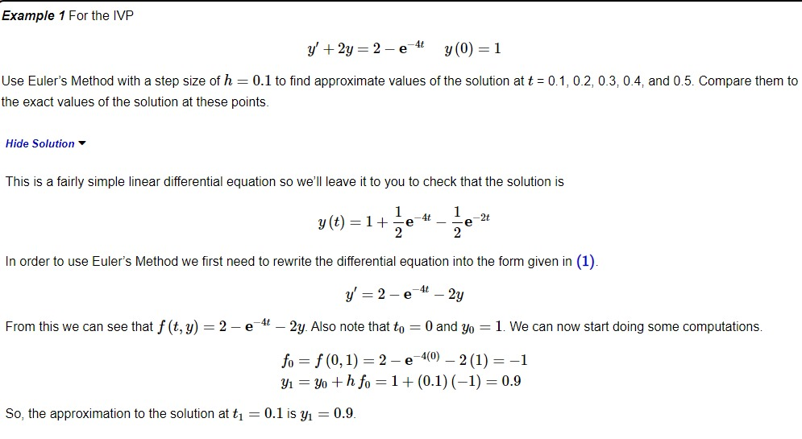

Slide 12
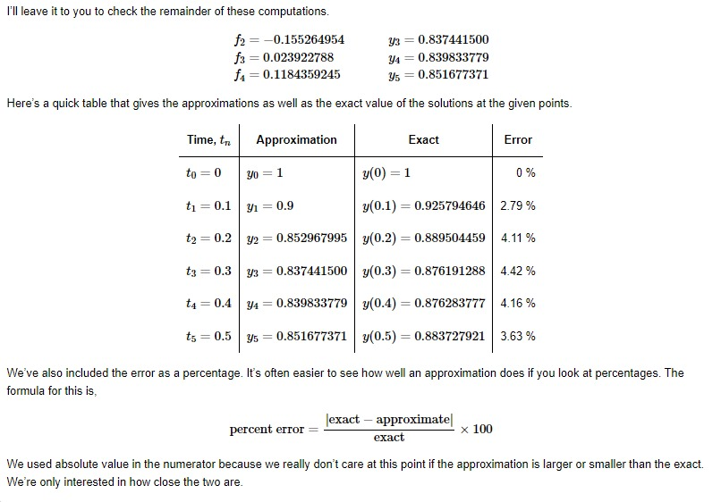

Slide 13
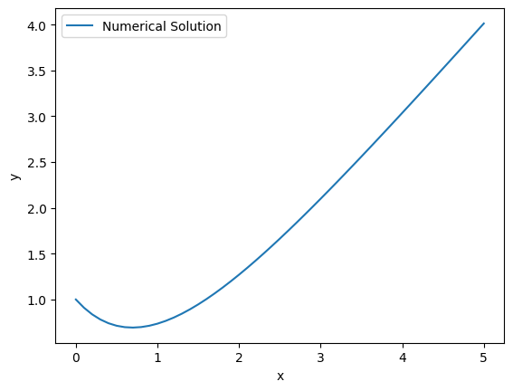
Runge-Kutta Methods for Solving ODE
import numpy as np
import matplotlib.pyplot as plt
# Define ODE and Runge-Kutta Method
def f(x, y):
return x - y
def runge_kutta_method(func, x0, y0, h, n):
x_values = [x0 + i * h for i in range(n+1)]
y_values = [y0]
for i in range(n):
k1 = h * func(x_values[i], y_values[i])
k2 = h * func(x_values[i] + h/2, y_values[i] + k1/2)
k3 = h * func(x_values[i] + h/2, y_values[i] + k2/2)
k4 = h * func(x_values[i] + h, y_values[i] + k3)
y0 += (k1 + 2*k2 + 2*k3 + k4) / 6
y_values.append(y0)
return x_values, y_values
# Example Usage
x0, y0 = 0, 1 # Initial conditions
h = 0.1 # Step size
n = 50 # Number of steps
x, y = runge_kutta_method(f, x0, y0, h, n)
# Plotting
plt.plot(x, y, label='Numerical Solution')
plt.xlabel('x')
plt.ylabel('y')
plt.legend()
plt.show()

Slide 14

Mastering Runge-Kutta Methods
Variant Selection
Comparing Variants
Understand the criteria for selecting the most appropriate variant of Runge-Kutta method based on accuracy and computational efficiency.
Explore the characteristics, advantages, and limitations of popular Runge-Kutta variants, including RK2, RK3, and RK4.
Optimization Techniques
Discover optimization techniques to enhance the performance of Runge-Kutta methods and achieve more accurate solutions.

Slide 15

Conclusion
As our journey through differential equations and numerical methods comes to an end, we hope you now appreciate the power and versatility of Euler's method and various Runge-Kutta methods. Keep exploring and applying these concepts to solve complex problems in the realm of ODEs. Thank you for joining us!

